Slide 1
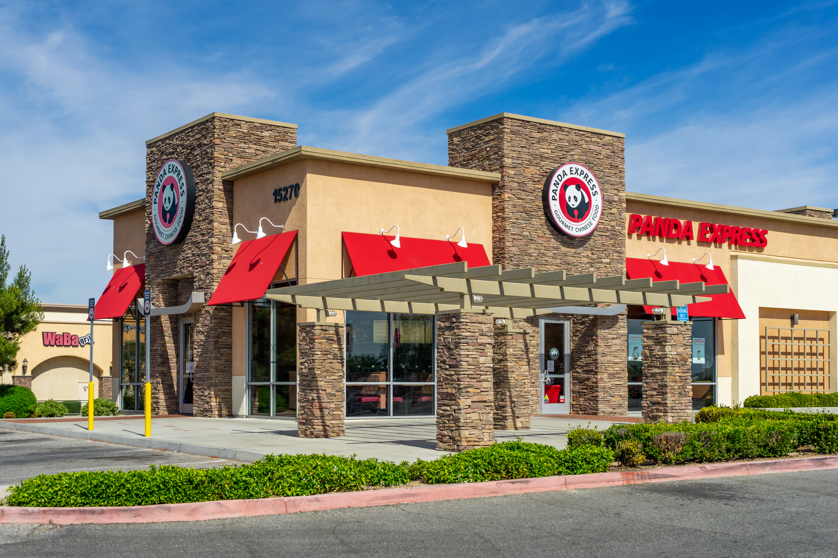
Panda Express Restaurant Analysis
Using Yelp and Census Data to Determine New Restaurant Locations
Condemned
Waterbucks

Slide 2
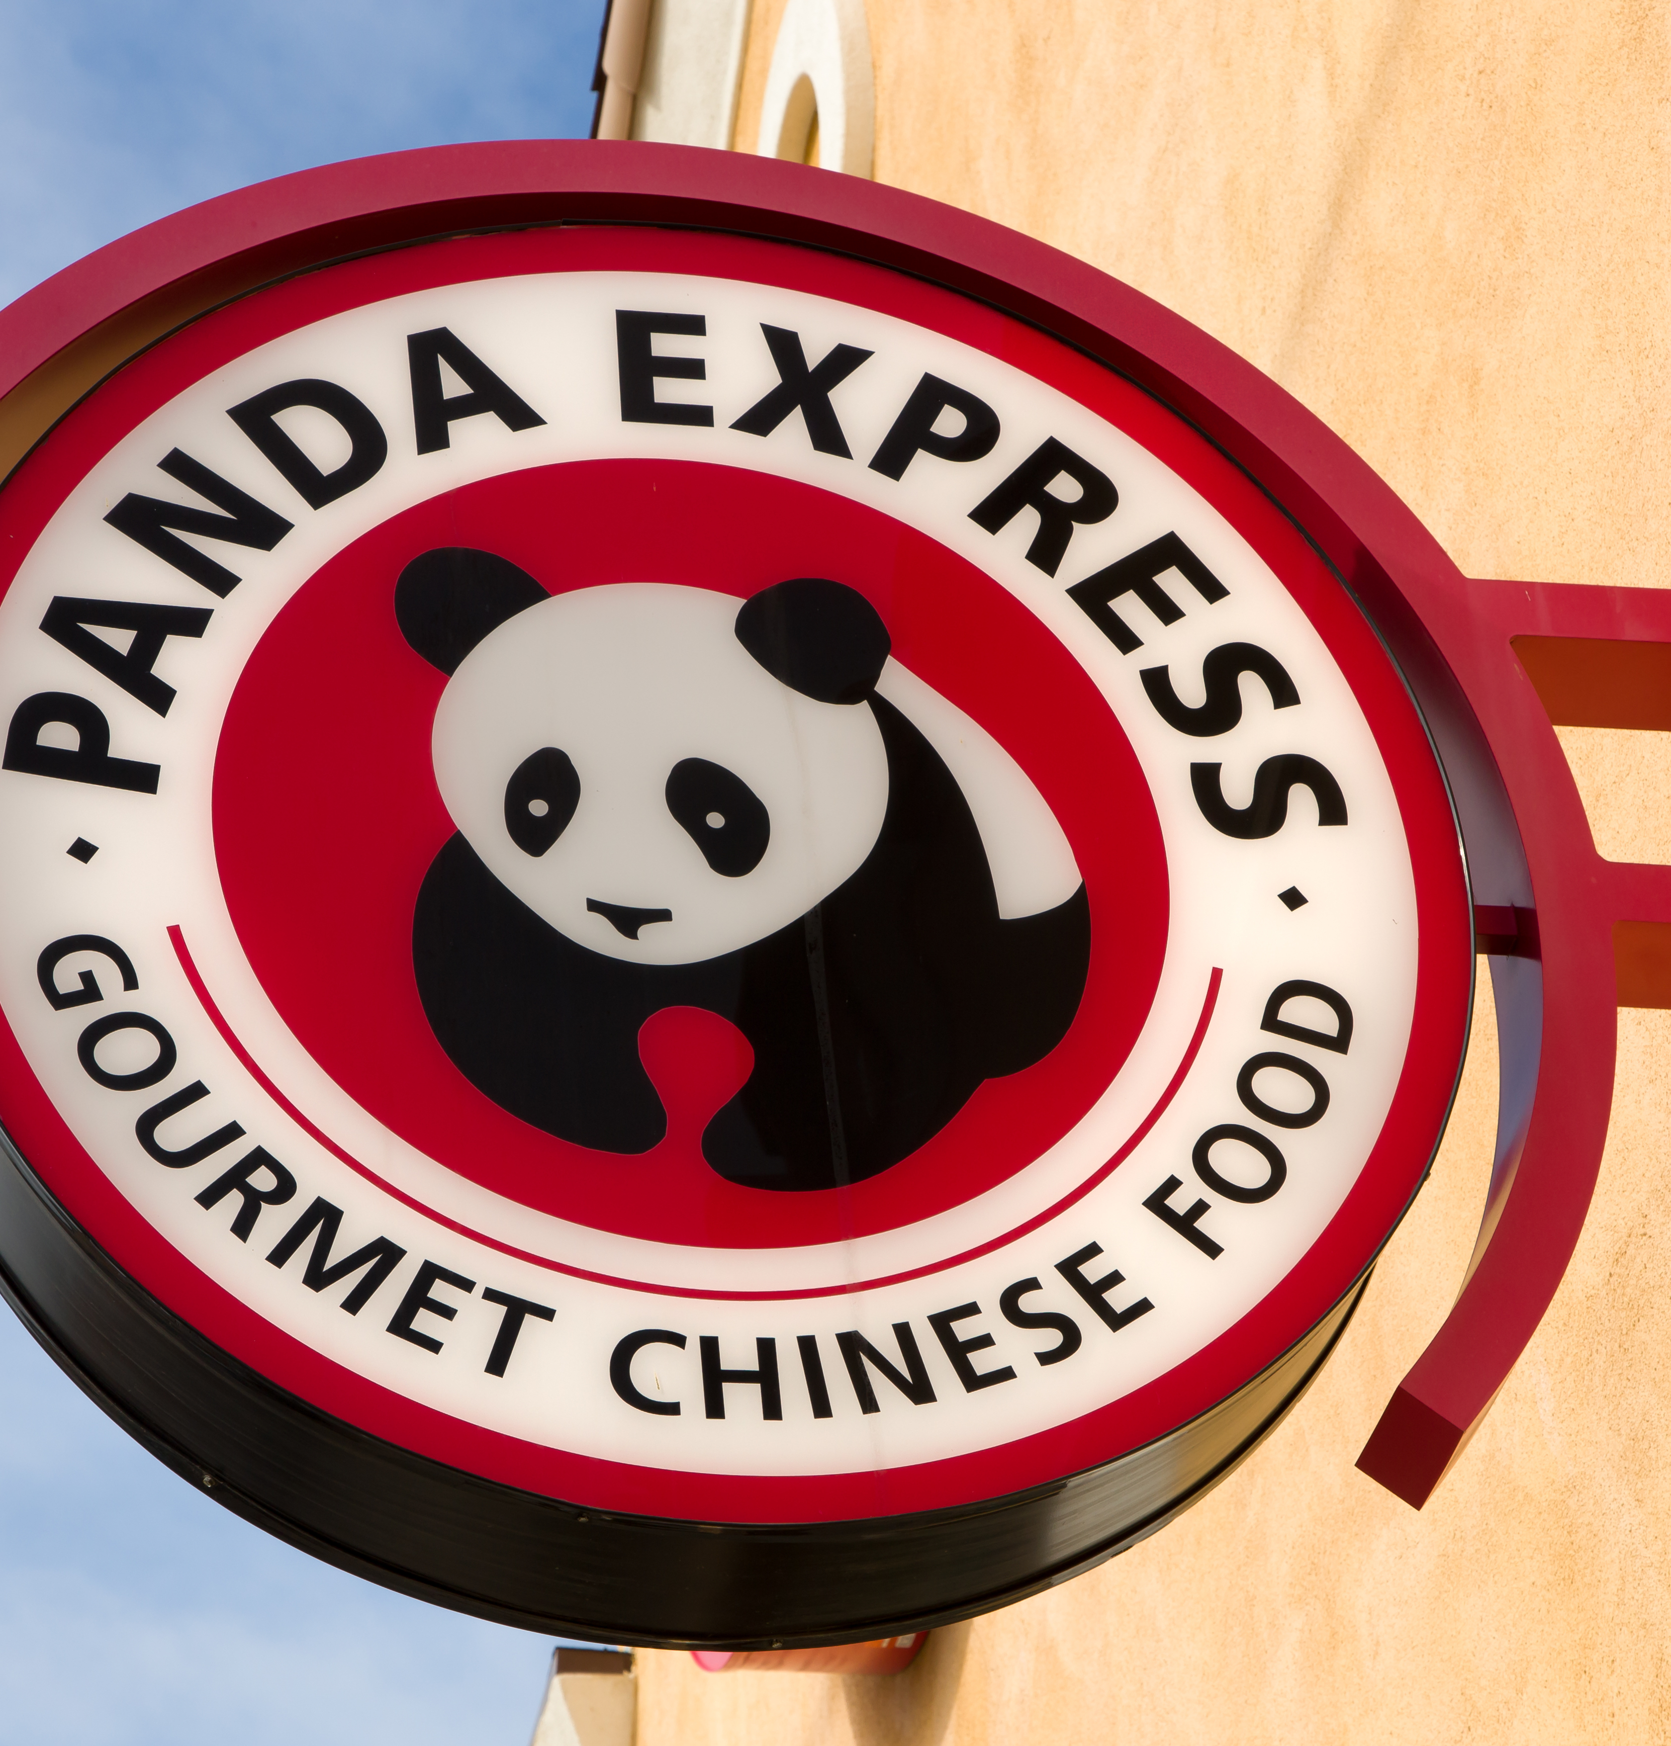
Questions
Question: Where should Panda Express open its new locations based on high Yelp ratings?
Goal: Increase Panda Express brand awareness and perception.
Null Hypothesis: Census, Availability, and Regional data do not affect Yelp ratings.
Alternative Hypothesis: Census, Accessibility, and Regional data affect Yelp ratings.

Slide 3



Dataset
Three distinct restaurants (cross-sectional dataset):
Panda Express
Chipotle
Red Lobster
5381 observations
19 different columns (variables) gathered from different API
Walkscore-API 1.0.1 (wrapper)
Existing Panda Express coordinates

Slide 4
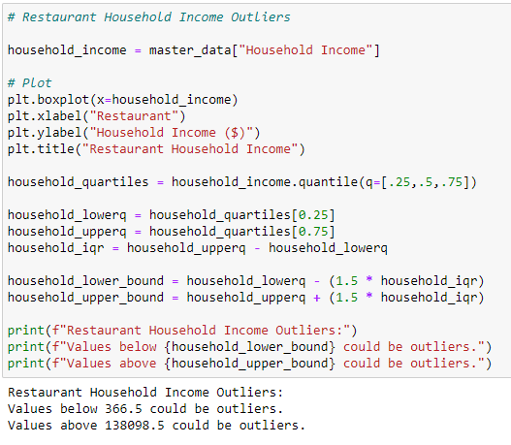
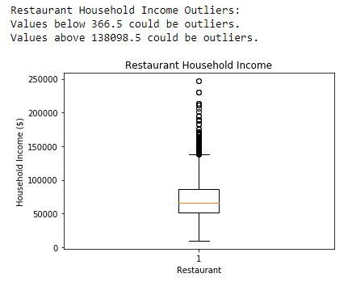
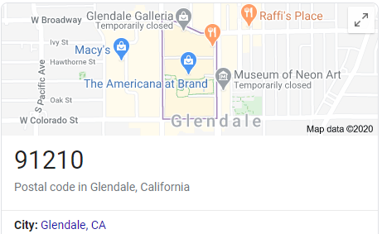
Outliers
Boxplots for every variable (household income, poverty count, walkability, etc.)
Calculation of Z-Score to obtain outlier count
Ultimately, we decided to leave the outliers within dataset
Boxplot Code:
Z-Score Code:
Notes:
Include example of “Glendale Mall” outlier

Slide 5
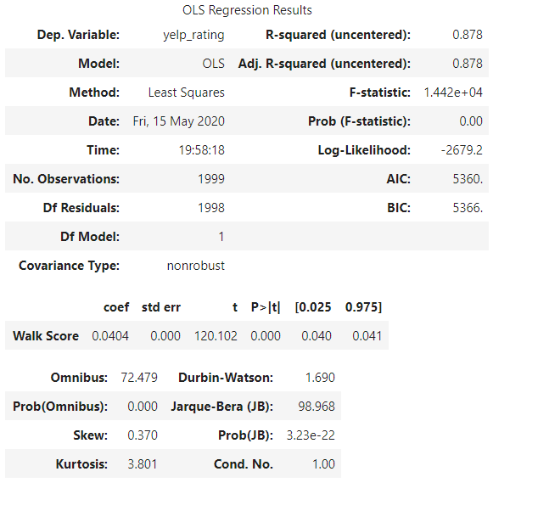
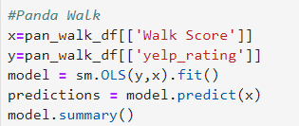
Census Data and Walk Score/Bike Score
Identify existing Panda Express locations. Compare yelp rating for these locations to regional census data and accessibility as measured by Walk Score and Bike Score
Census Data Used
Population
Median Age
Average Household Income
Per Capita Income
Poverty Rate
Unemployment Rate
Walk Score Data Used
Walkscore
Bikescore
Combining Data Sets
Census Data associated to Panda Express location by address
Walk Score & Bike Score Data associated to Panda Express location by latitude and longitude
Output:
Regression Code:

Slide 6
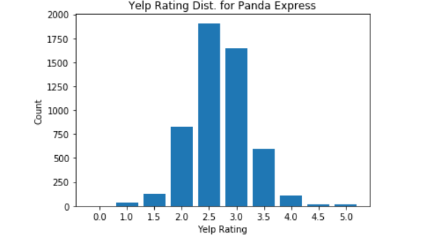
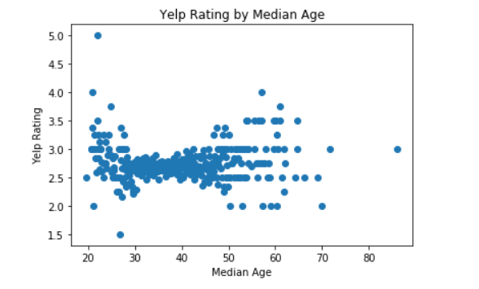
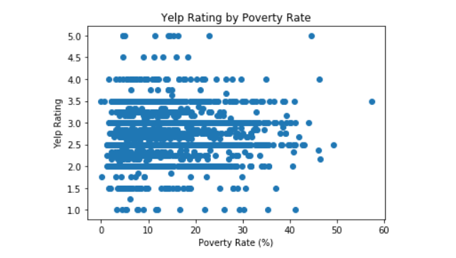
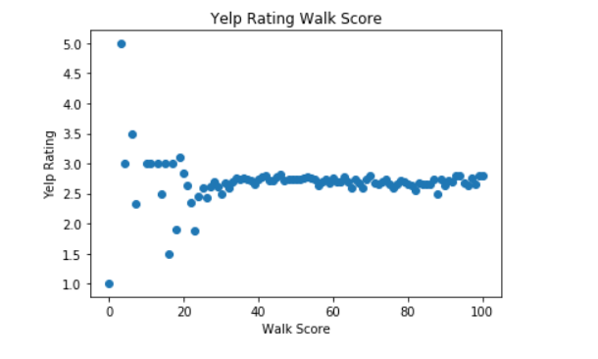
Census Data and Walk Score/Bike Score Correlation Analysis
Linear regression for yelp rating to variables identified for analysis.
Variables | R-Squared Value
Population | 0.762
Median Age | 0.937
Average Household Income | 0.847
Per Capita Income | 0.824
Poverty rate | 0.697
Unemployement rate | 0.822
Walk Score | 0.878
Bike Score | 0.878

Slide 7
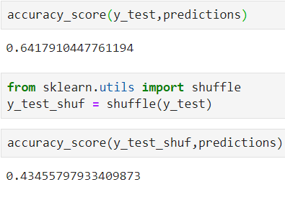
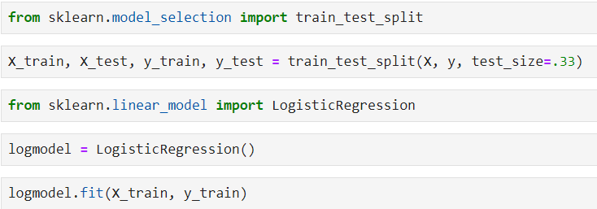
Logistic Regression
How good are our numerical variables at predicting the three different restaurants?
Verification process
No feature creation/engineering
Model predicts about 20% better than a random model.

Slide 8
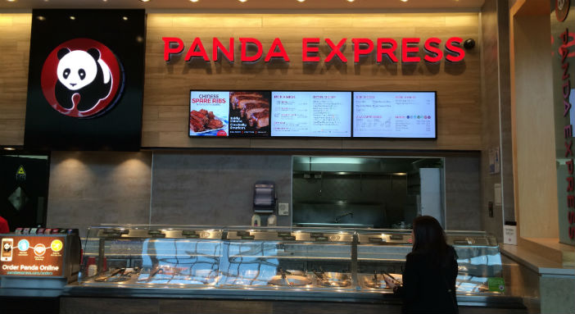
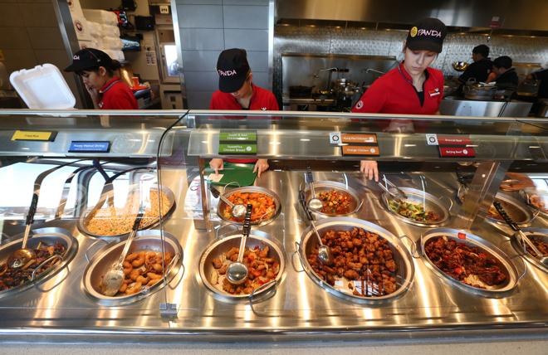
Methods
What methods were used when conducting this analysis?
Multivariate Linear Regression
Independent Variables:
Census Data
Accessibility Data (Walk and Bike)
Regional Data
Predict Yelp Ratings
Use multivariate linear regression to predict Yelp ratings in locations where there are currently no Panda Express restaurants
Rank by Yelp rating
Choose to open new locations where our predictions have the highest Yelp ratings

Slide 9
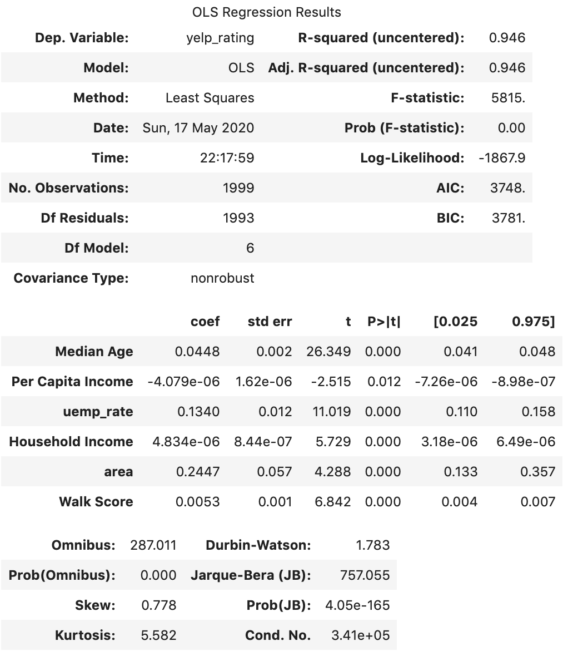
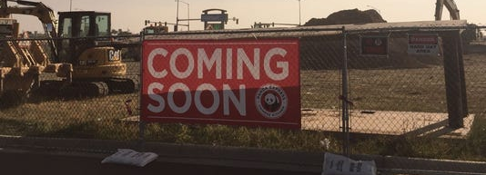
Linear Regression
Significant variables:
Area (Either East Coast or Non-East Coast
Unemployment Rate
Age
Walk Score

Slide 10
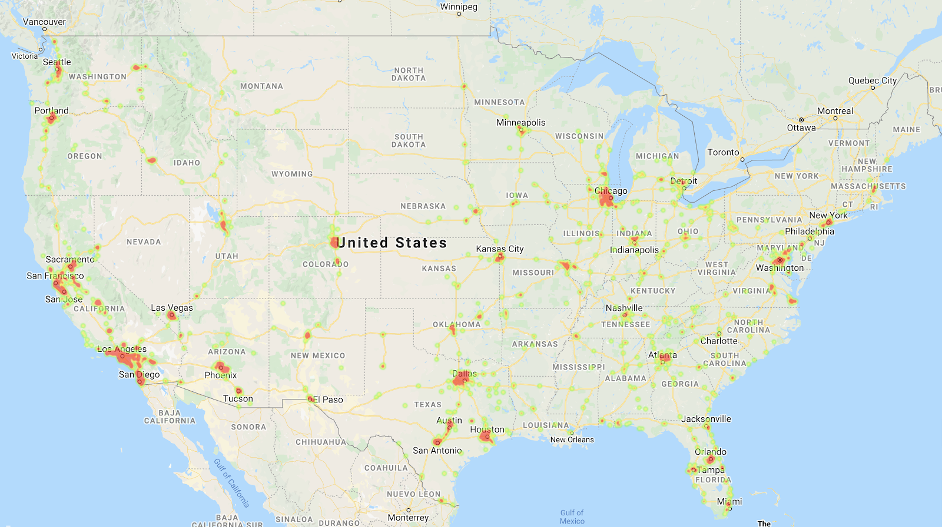
Final Product
Heatmap based on Yelp ratings of all existing Panda Express restaurant locations

Slide 11
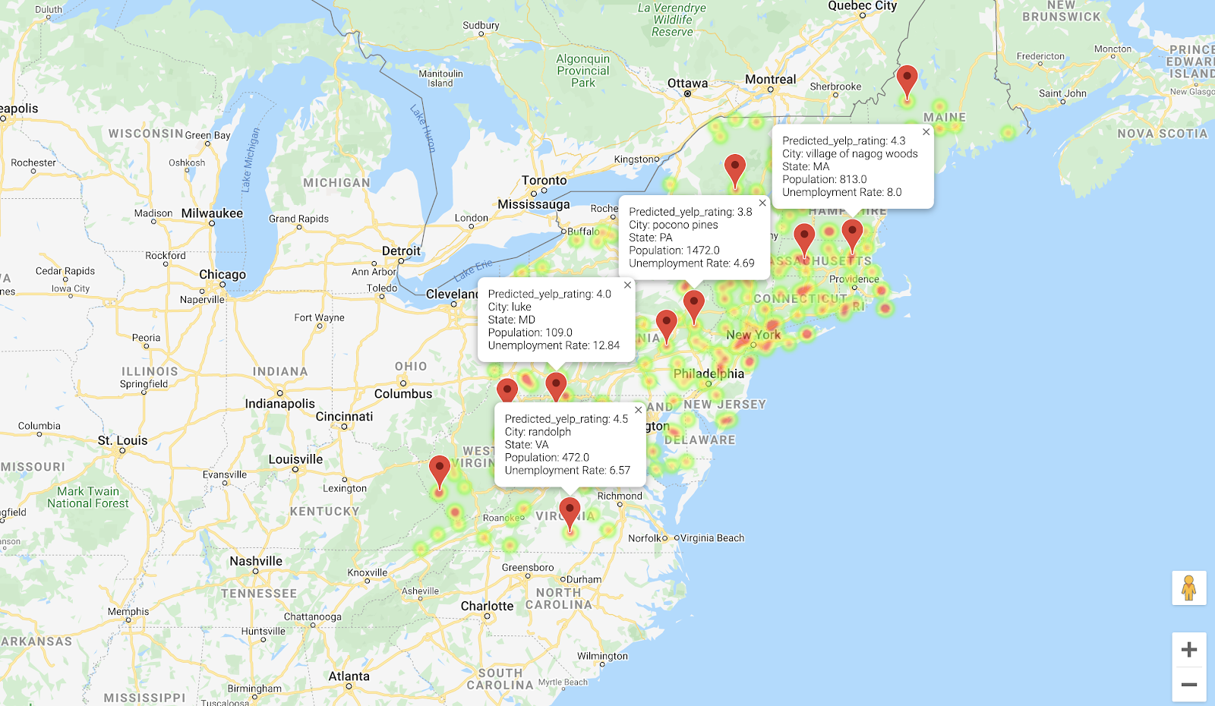
Final Product
Heatmap of predicted Yelp ratings of Panda Express locations in the East Coast

Slide 12
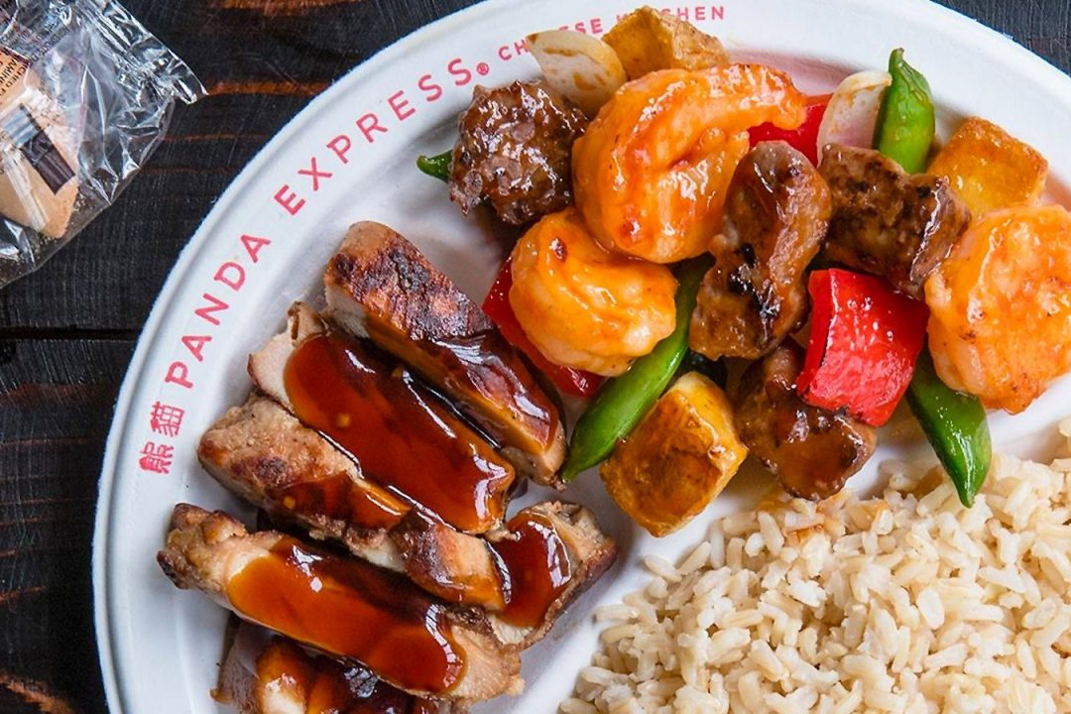
Summary
Variables that are significant to the Yelp ratings for Panda Express are:
Area (Either East Coast or Non-East Coast)
Unemployment Rate
Age
Walk Score
The Wallk score correlation to Bike score is similar and there is less impact. Poverty rate had least correlation to Yelp rating. The Walk and Bike scores were tied for #2 with Median age.

Slide 13
Summary
Heatmap of predicted Yelp ratings of Panda Express locations in the East Coast

Slide 14
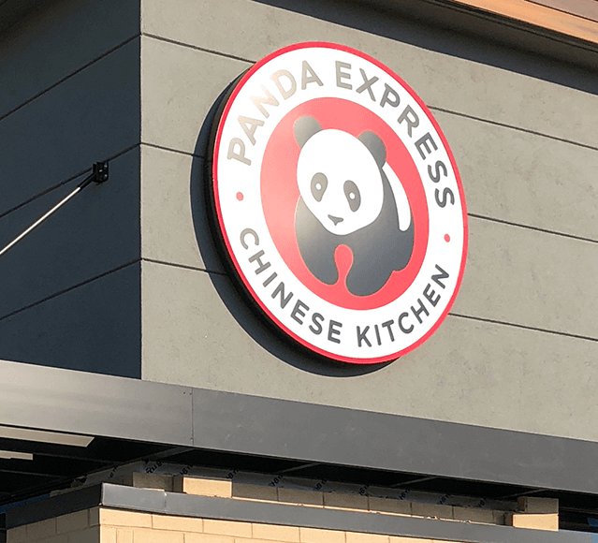
Limitations/Future Analysis
Limitations:
Yelp ratings is not the best indicator for determining where Panda Express should open a new store
Data availability—Lack of financial data
Besides the variables we have in the dataset, we can gather more variables to predict the output e.g. number of restaurants in each city
Future Analysis:
Obtain historical store opening data to see how successful each store was. We can determine what is the common indicator in creating a successful store
Perform a sentiment analysis on Yelp reviews and relate that to Yelp ratings
Collect more data

Slide 15
Thank you!

